Slide 1
Ground Control Station Flight conTrol
Tim Molloy

Slide 2
Ground Control Station
HLO-5 Ground Control Station
SR-B-08 and 09 Receive and Transmit Telemetry via WLAN
SR-D-07 and 08 Log Telemetry and Uplink Commands
SR-D-09 Display of State and Control Data
SR-D-10 System Status Display
Received and Transmit Consoles and Data Logger
Data Plotters & Artificial Horizon
System Status Widget
Communications and Vicon Threads; Gains and Parameter Widgets
SR-B-02 Flight Mode Switching
Flight Control Widget

Slide 3
GCS Design (Architecture)

Slide 4
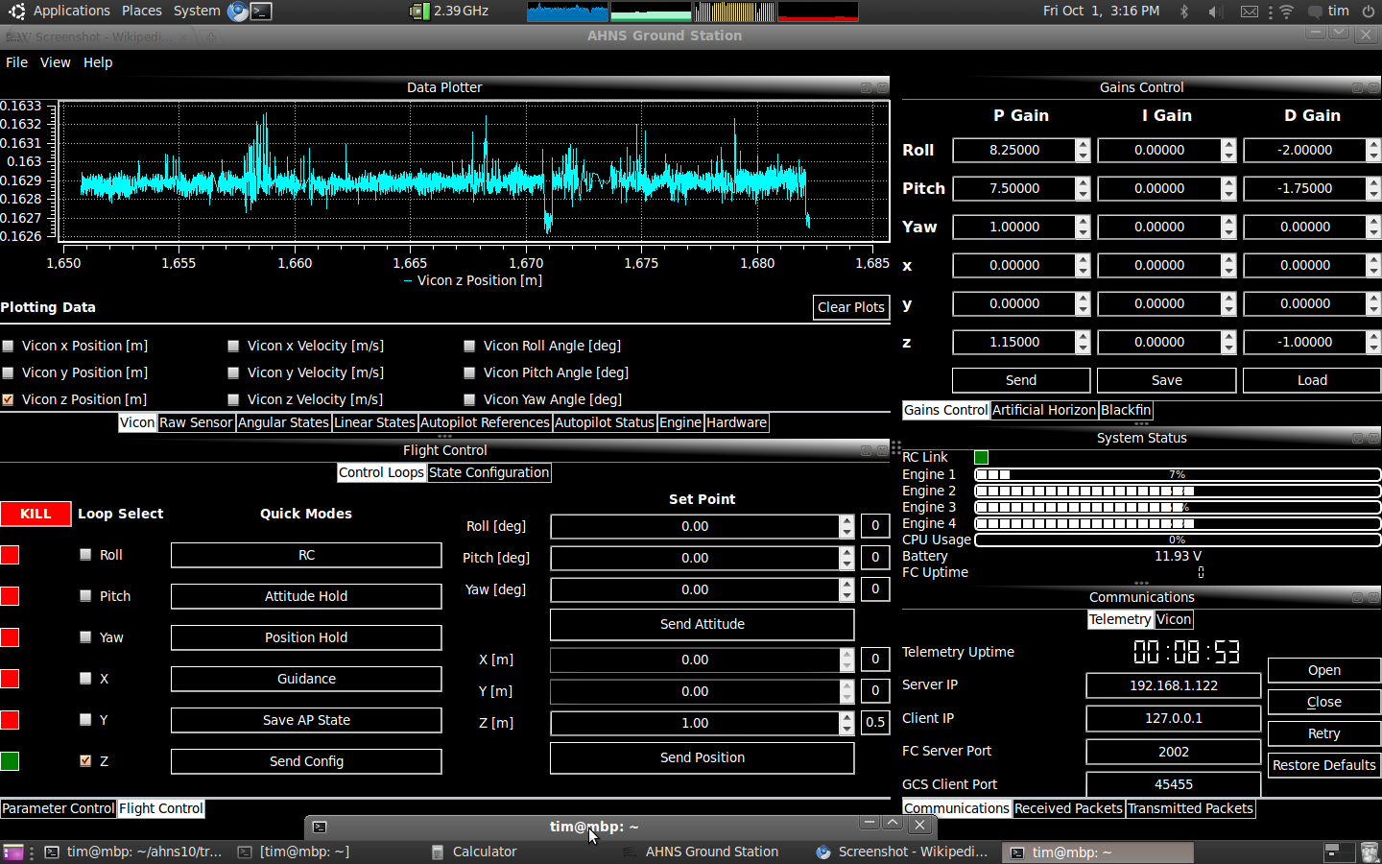
GCS Implementation (User Interface)

Slide 5
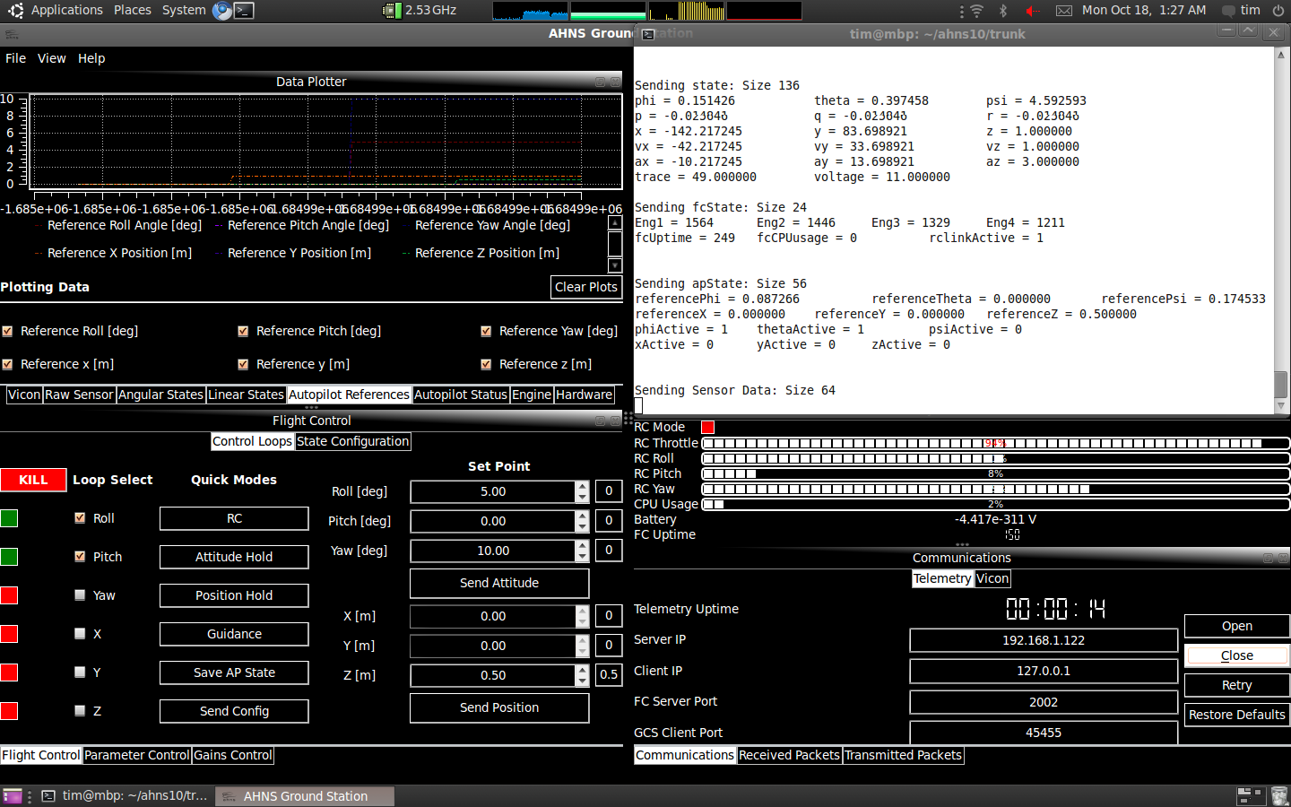
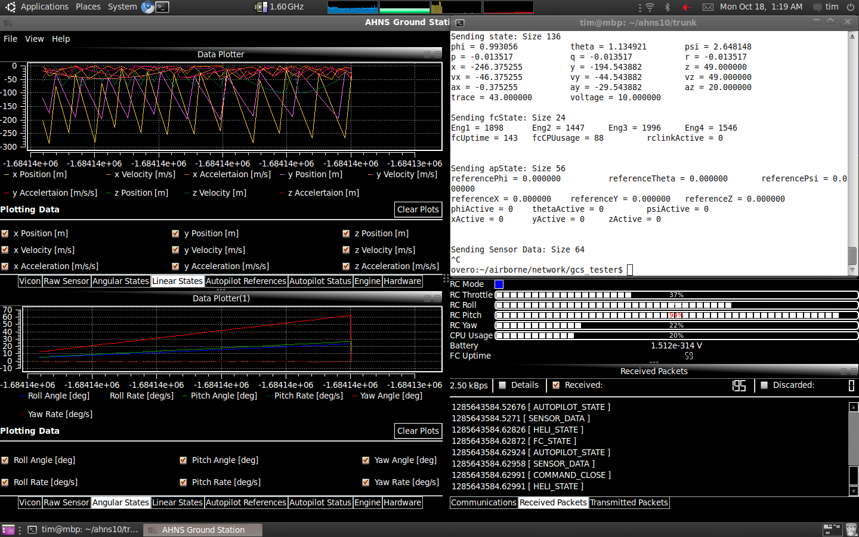
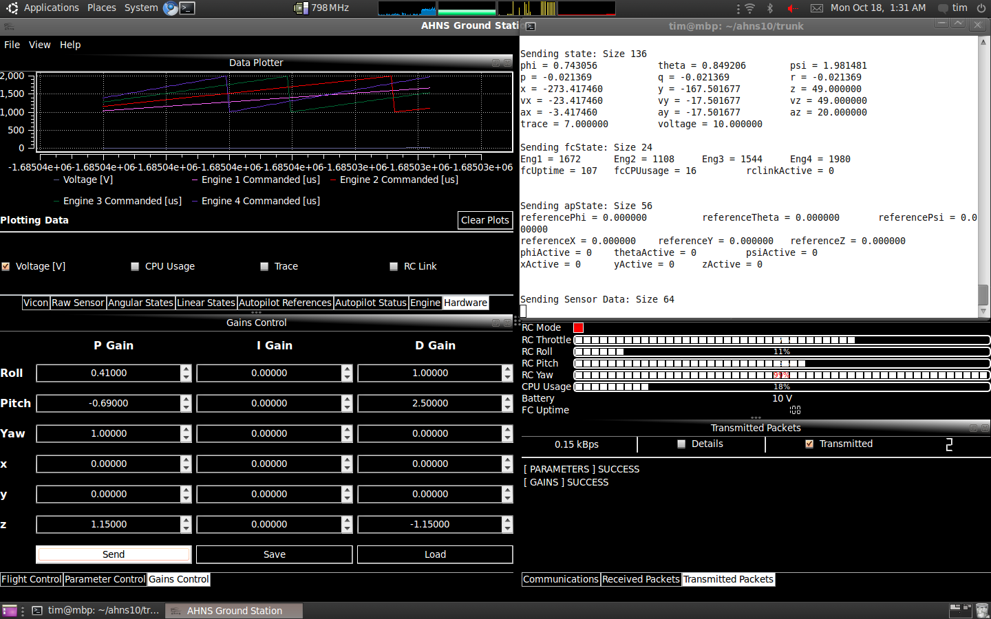
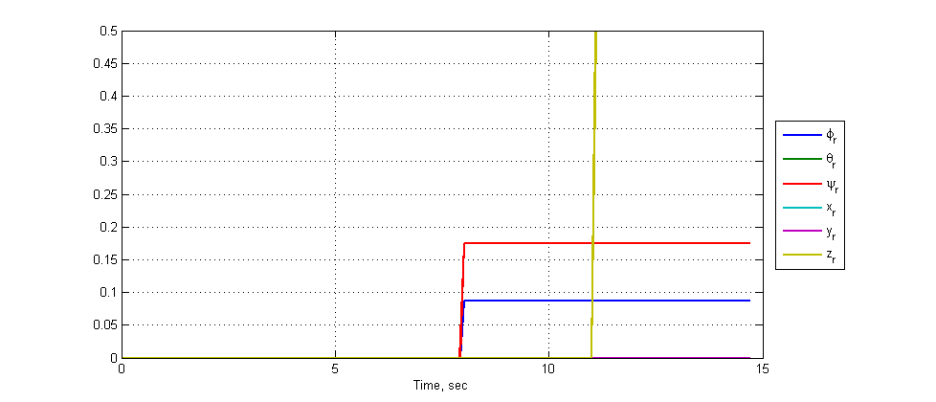
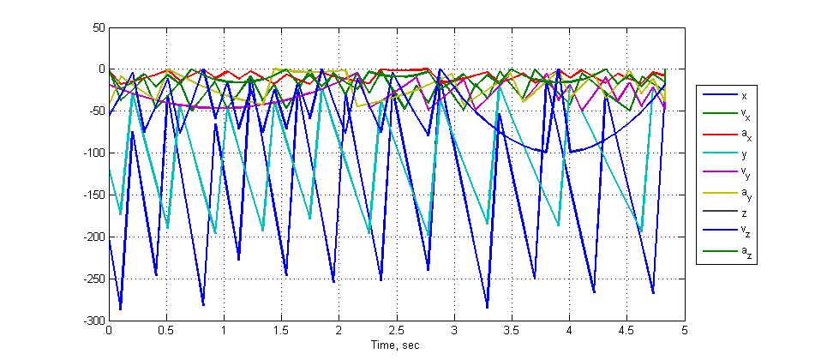
GCS Acceptance Testing
HLO-5 Ground Control Station
SR-B-09 and 08 Receive and Transmit Telemetry via WLAN
SR-D-07 and 08 Log Telemetry and Uplink Commands
SR-D-09 Display of State and Control Data
SR-D-10 System Status Display
SR-B-02 Flight Mode Switching
AT-02
AT-08
AT-17 and AT-18
AT-19
AT-20
AT-09
Documented in AHNS-2010-GC-TR-001

Slide 6
Flight Control
HLO-4 Autonomous Hovering Flight
SR-B-10 PID Control Methodology
SR-D-03 Stability Augmented Flight
SR-D-04 Autonomous Station-keeping
Control Architecture
Attitude Control
Guidance
Static Angle Setpoints
Dynamic Angle Setpoints
Dynamic Angular Rate Setpoints
SR-B-03 50Hz Control Rate
Control and Mode Control Unit Flight Computer Update Rate

Slide 7
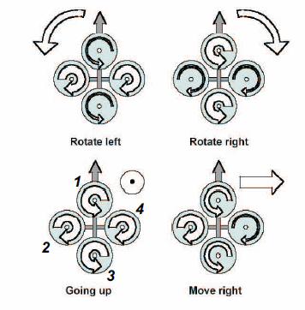
Quadrotor Control
Thrust Altitude Control Forces
Thrust Roll Control Forces
Thrust Pitch Control Forces
Drag Yaw Control Forces

Slide 8
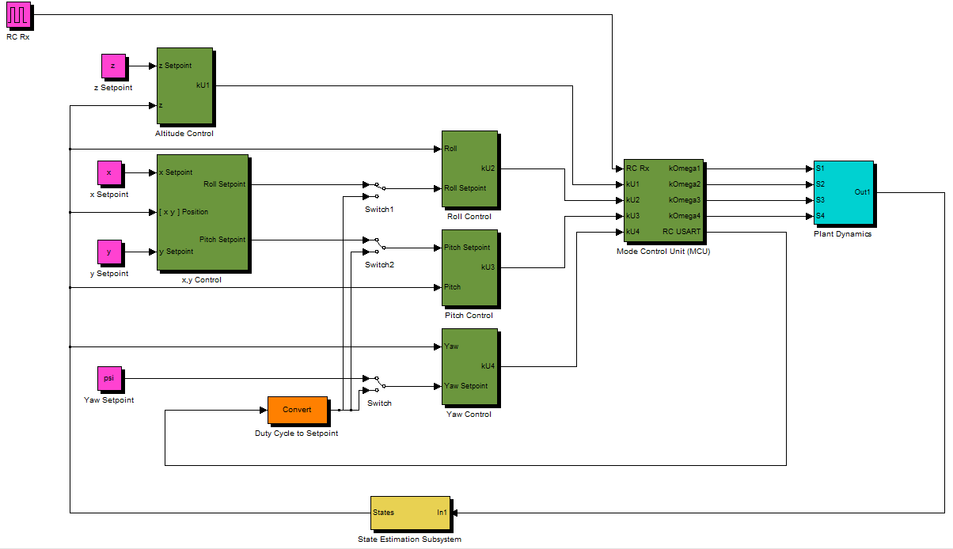
Flight Control (System Architecture)
Position Control
Attitude Control

Slide 9
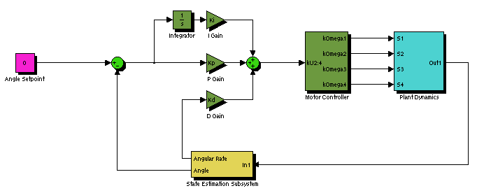
Static Angle Based Attitude Control
Developed in simulator
Implemented and Tested in Test Rig
Did not afford attitude control and removed safety pilot from loop

Slide 10
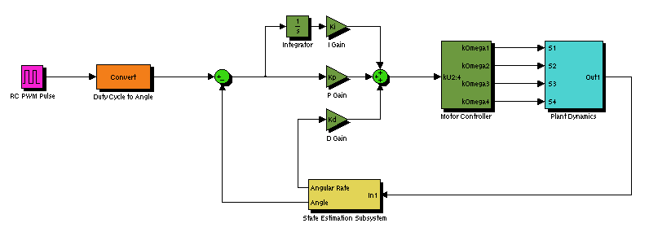
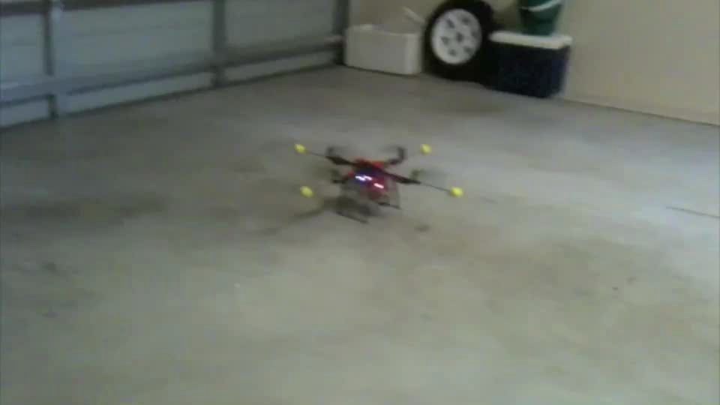
Dynamic Angle Based Attitude Control

Slide 11
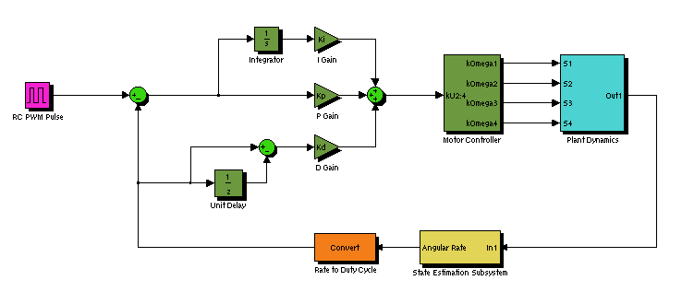
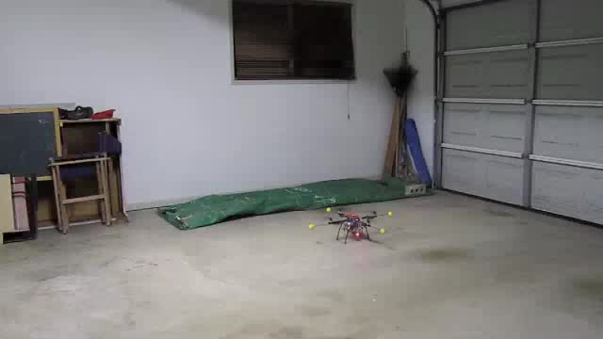
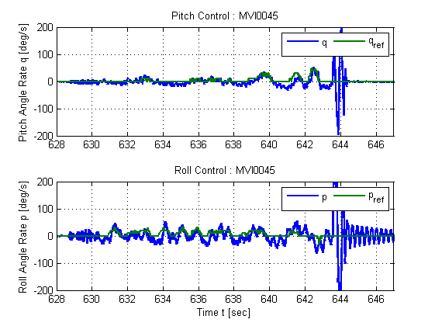
Dynamic Rate Based Attitude Control

Slide 12
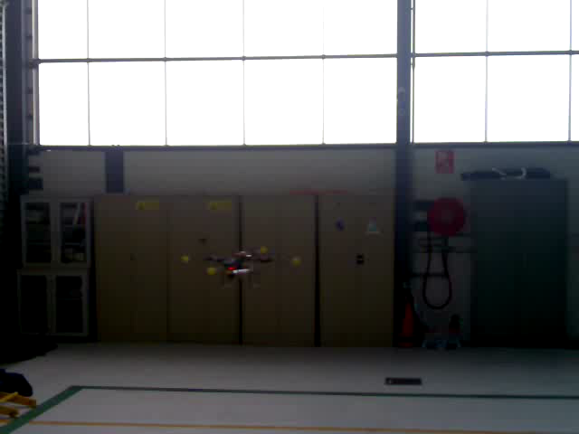
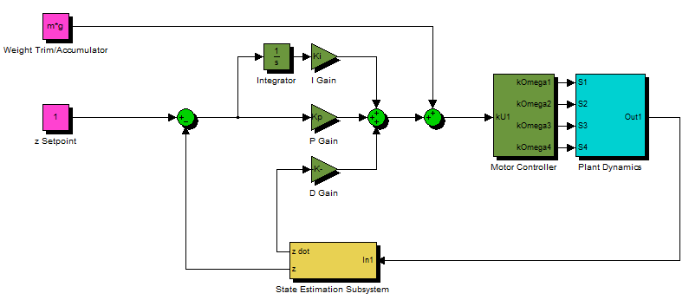
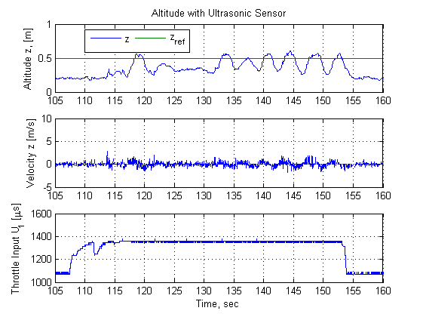
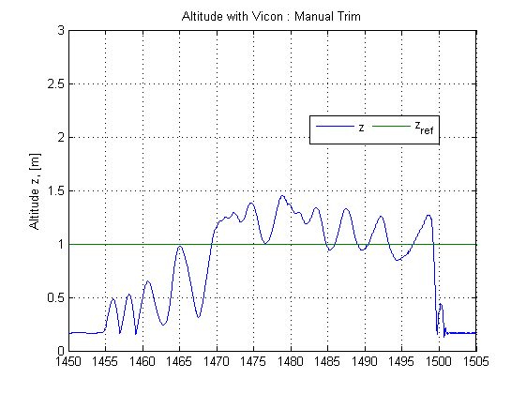
Altitude Control

Slide 13
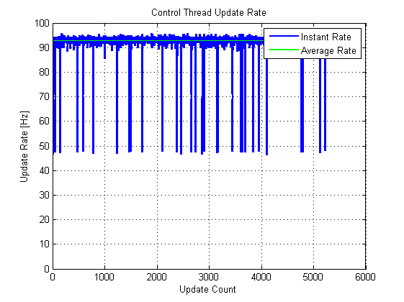
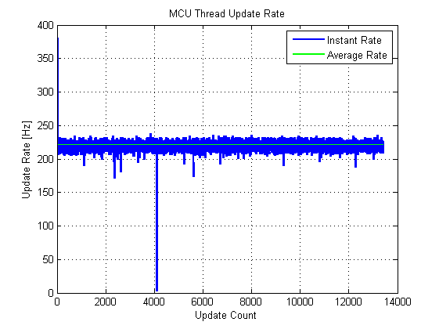
Flight Control Acceptance Testing
HLO-4 Autonomous Hovering Flight
SR-B-10 PID Control Methodology
SR-D-03 Stability Augmented Flight
SR-D-04 Autonomous Station-keeping
AT-10
AT-13
AT-14
SR-B-03 50Hz Control Rate
AT-03

Slide 14
Lessons Learnt
GCS
Emphasis on modular design, unit testing and documentation tools to maximise code reuse
Avoidance of “from scratch” development
Control
Separation of State Estimation and Controller Testing
Reliance on controller designs based on proven implementations rather than simulations
Limitations on use of testing apparatus to mitigate risks
Effects of PWM resolutions on control performance
Avoidance of USART Update Limitations in Control

